Slide 2
Session 9 – Probability and Counting
Session 9
The basic counting methods
Counting using sets
Probability
4.1 The basic counting methods
4.1.1 Counting in which order is important (Permutations)
4.1.2 Counting in which order is not important. (Combinations)
4.1.3 Summary of strategies for counting problems
4.2 Counting using sets
4.3 Probability
4.3.1 Independent events

Slide 3
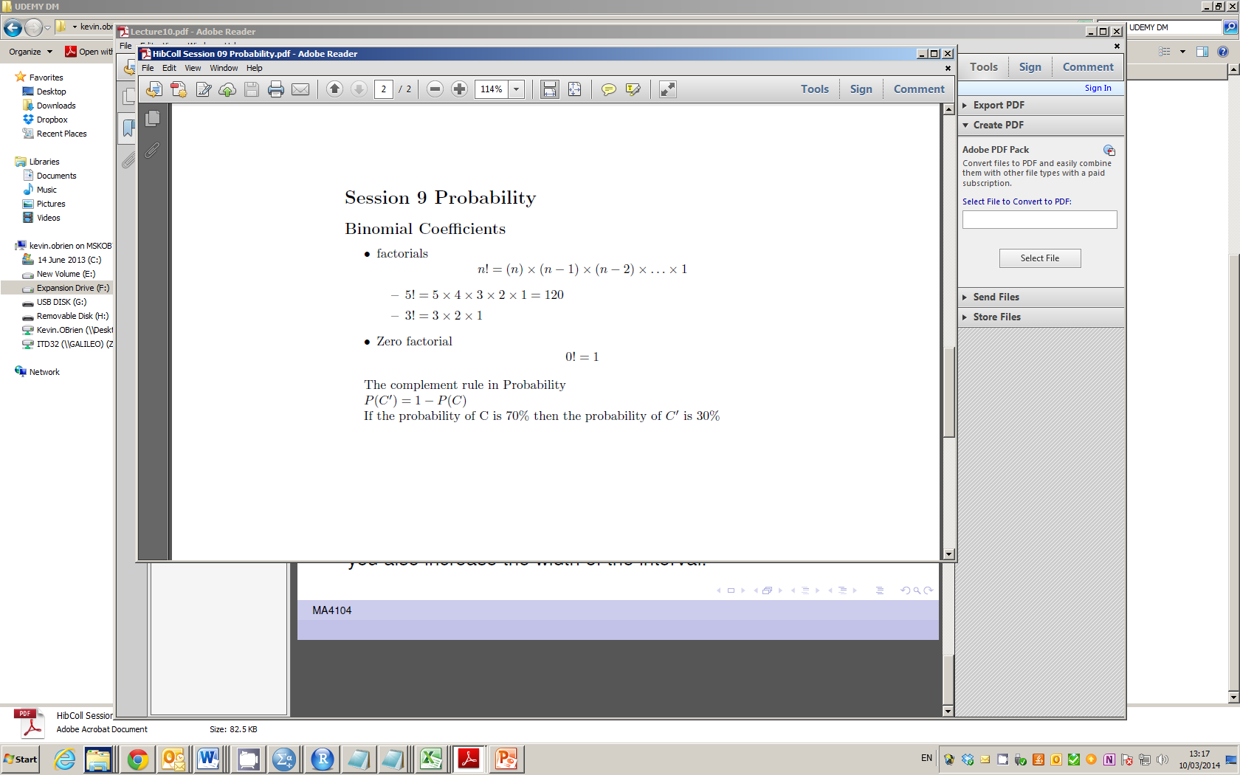
Factorials

Slide 4
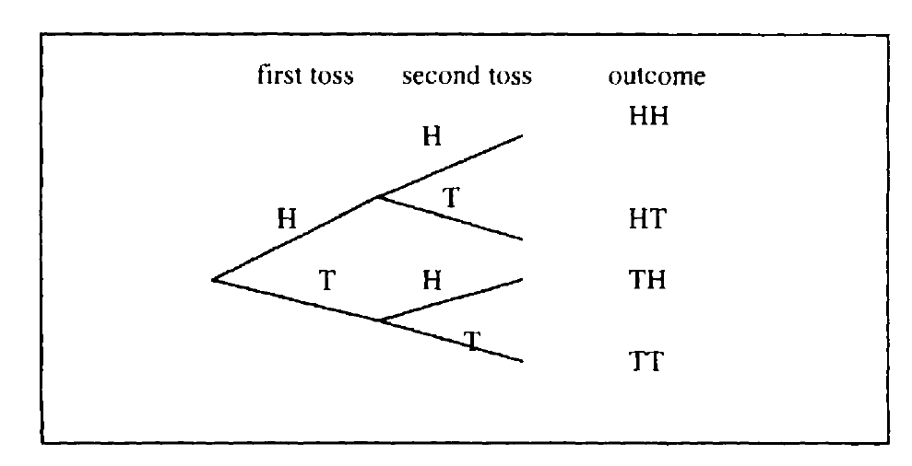
Multiplication Principle (Remark on Ordering)

Slide 5
Session 9 : Counting and Probability
Counting
Multiplication Rule
Factorials
Choose Operators
Permutations - ordered subsets
Combinbations - how many ways
Probability
Independent Events
Axioms of Probability

Slide 6
Permutations
Permutations (full set of n items)
Number of permutations (no repetition) : n!
Set = A,B,C (3 items)
6 Permutations (3!)
ABC | BAC | CAB
ACB | BCA | CBA

Slide 7
Permutations
Permutations when repetition is allowed
Number of permutations n^{n}
Little practical use for this. not part of course

Slide 8
Permutations
Ordered subsets
k items selected from n items
Ordering is important
Number of permutations : n! / (n-r)!

Slide 9
Probability
Independent Events
First consider : Are events independent?
P(A and B) = P(A) x P(B)

Slide 10
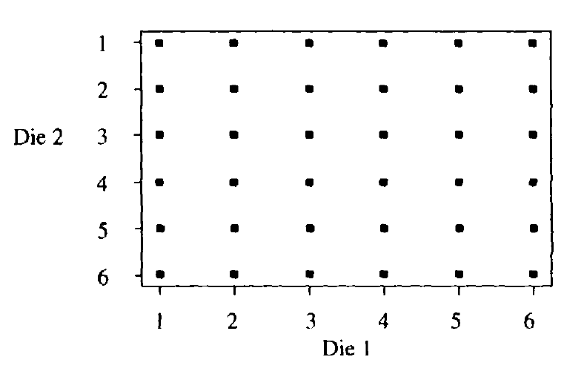
Multiplication Principle (Remark on Ordering)

Slide 11
Combinations and Permutations
If the order doesn't matter, it is a Combination.
If the order does matter it is a Permutation.
A Permutation is an ordered Combination.
There are basically two types of permutation:
Repetition is Allowed: PIN Numbers - could be "3133".
No Repetition: for example the first three people in a running race. A runner can't be first and second.

Slide 12
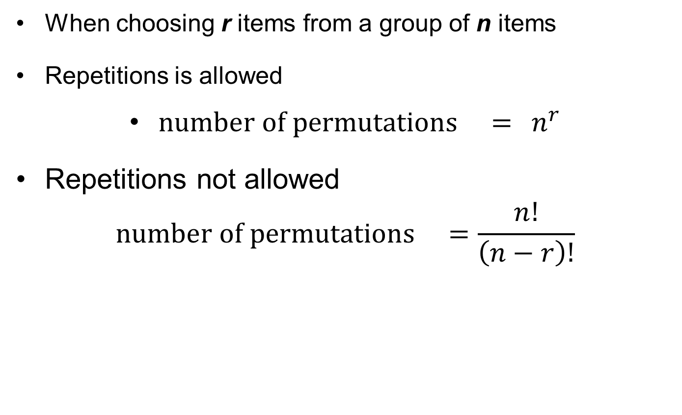
Permutations
When choosing r items from a group of n items
Repetitions is allowed
$number of permutations ={ n}^{r}$
Repetitions not allowed
$$number of permutations =\frac{n!}{\left(n−r\right)!}$$

Slide 13
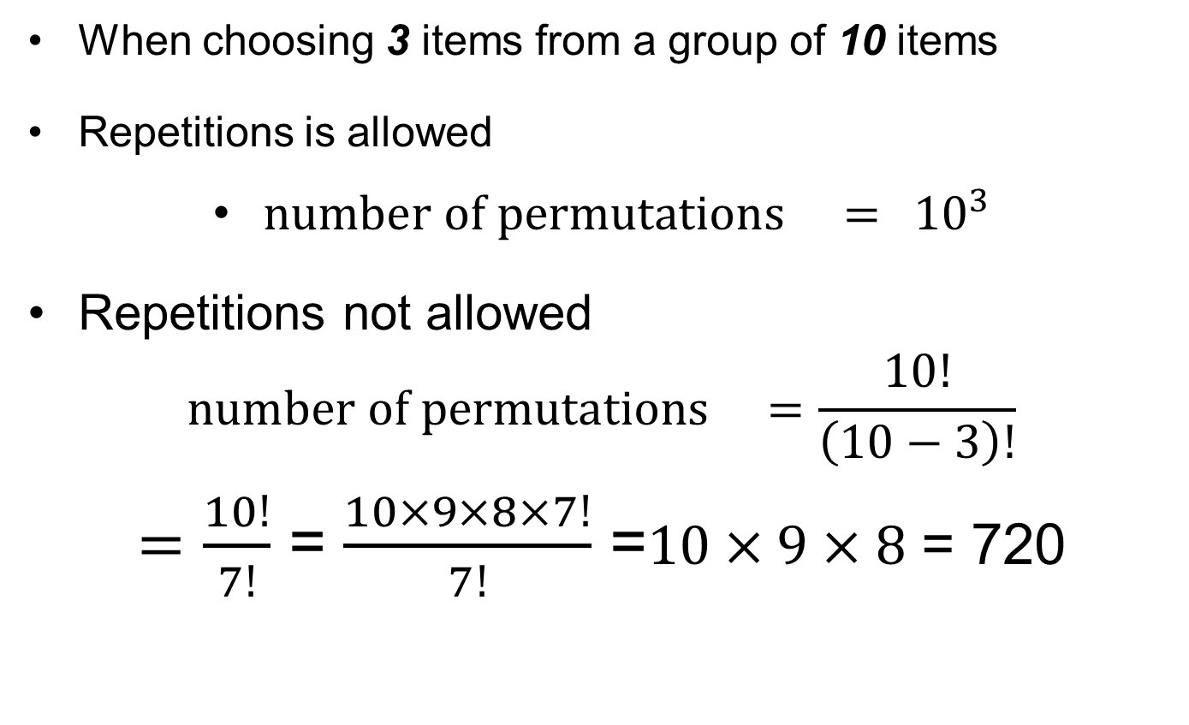
Permutations
When choosing 3 items from a group of 10 items
Repetitions is allowed
$number of permutations ={ 10}^{3}$
Repetitions not allowed
$$number of permutations =\frac{10!}{\left(10−3\right)!}$$
$=\frac{10!}{7!}$ = $\frac{10×9×8×7!}{7!}$ =$10×9×8$ = 720

Slide 14
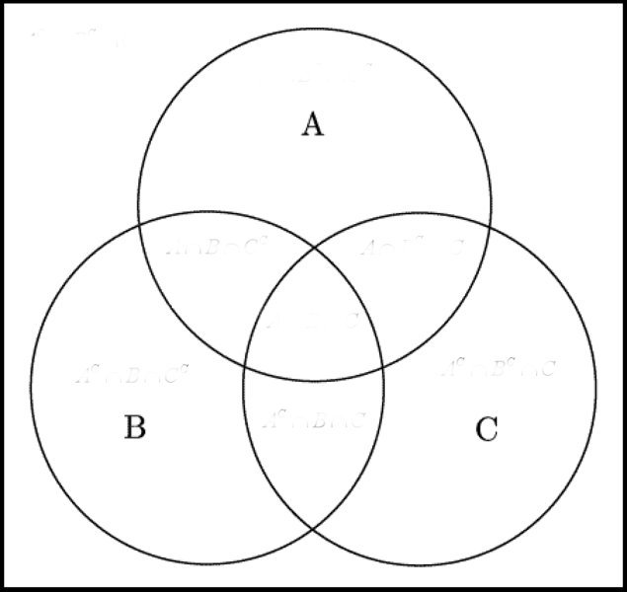
Venn Diagrams

Slide 15
Venn Diagrams
300 People
100 Americans
140 Boys
80 Cyclists
40 American Cyclists
50 Boy Cyclists
60 American Boys
20 American Boy
Cyclists

Slide 16
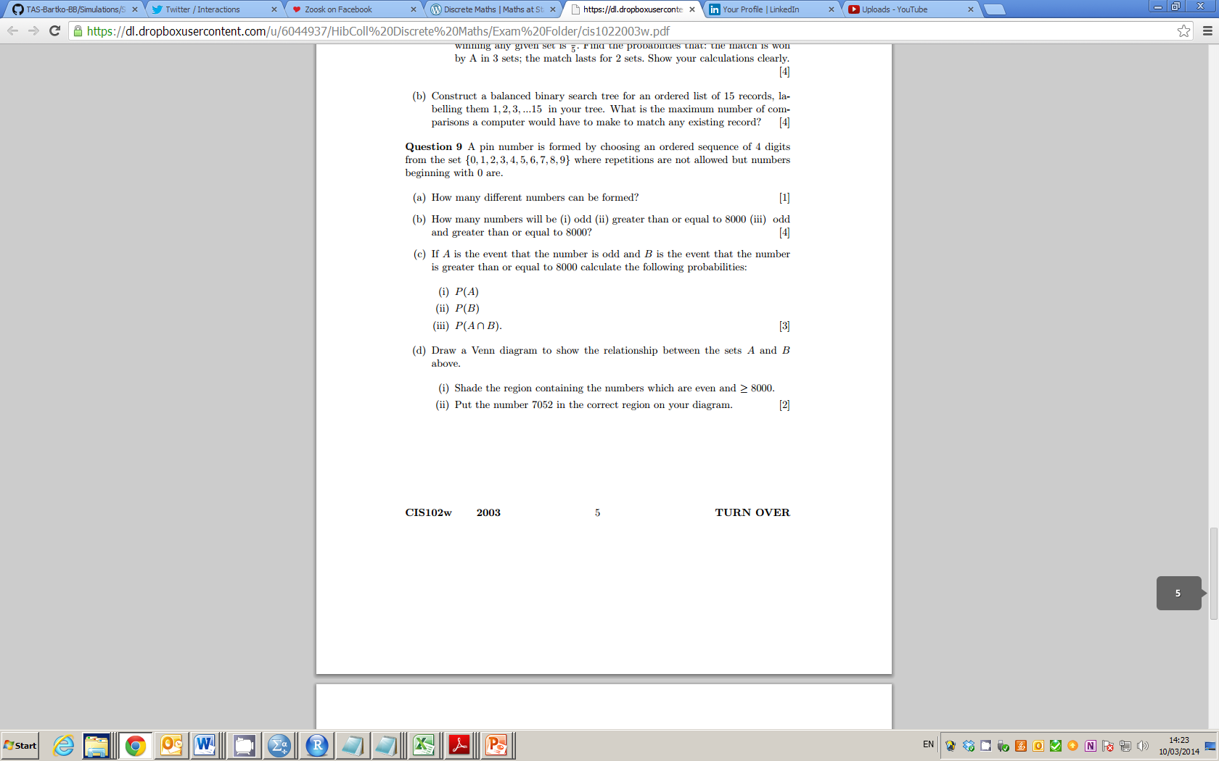
2009 Question 9

Slide 17
2009 Question 9

Slide 18
2009

Slide 19
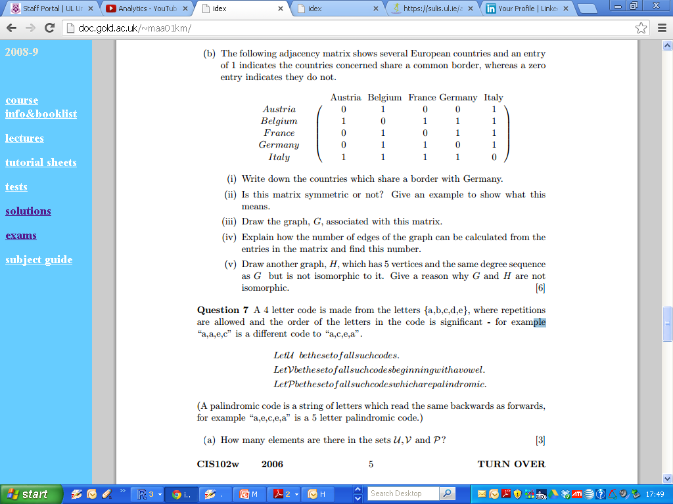
2006 Zone B Q7

Slide 20
2006 Zone B Q7

Slide 21
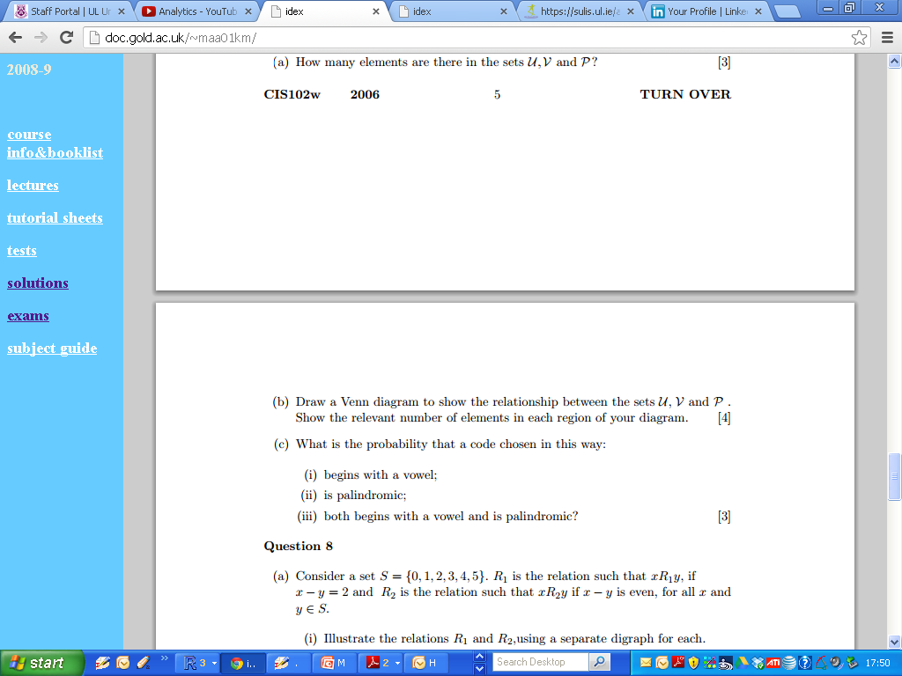
2006 Zone B Q7

Slide 22
2006 Zone B Q7

Slide 23
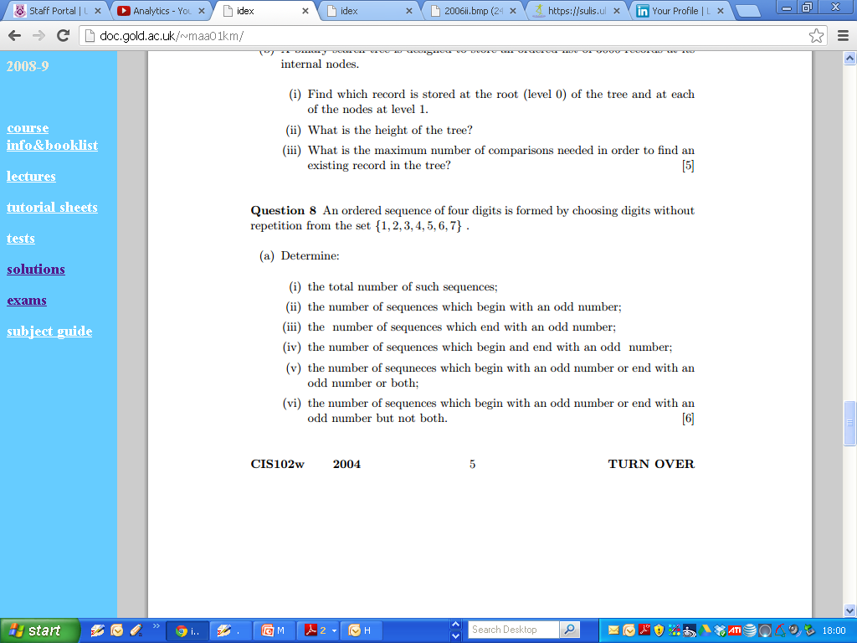
2004 Question 8

Slide 24
2004 Question 8

Slide 25
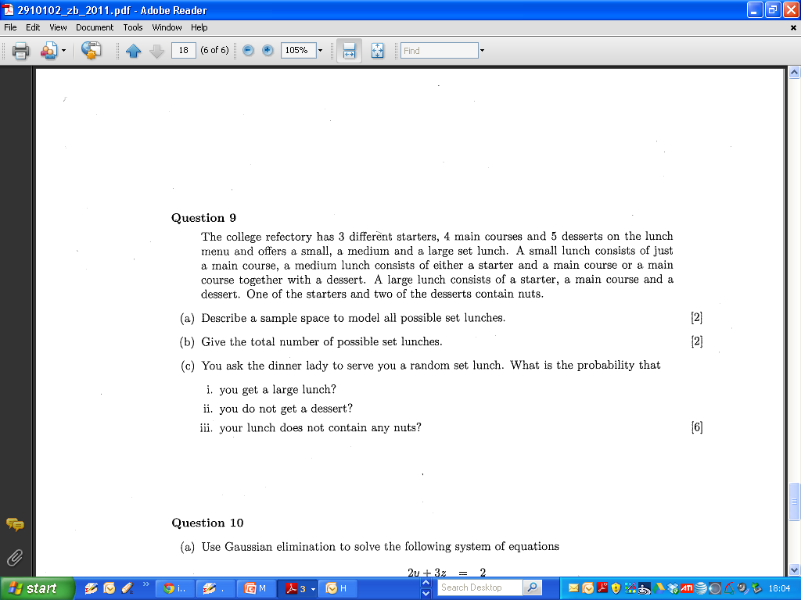
2011 Question 9

Slide 26
2011 Question 9

Slide 27
2011 Question 9

Slide 28
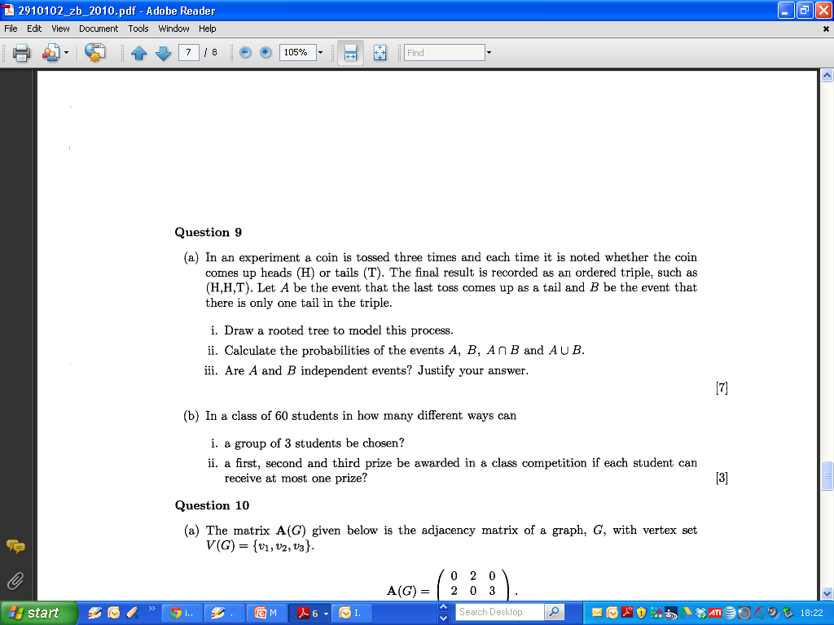
2010

Slide 29
2010 Zone B

Slide 30
2010 Zone B

Slide 31
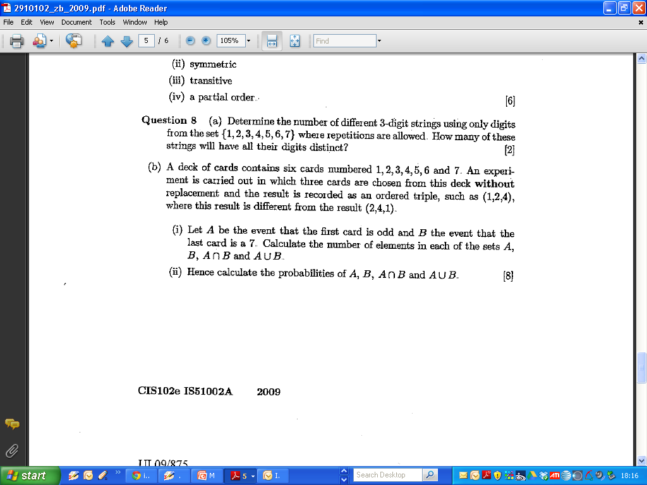
2009 Zone B

Slide 32
2009 Zone B

Slide 33
2009 Zone B

Slide 34
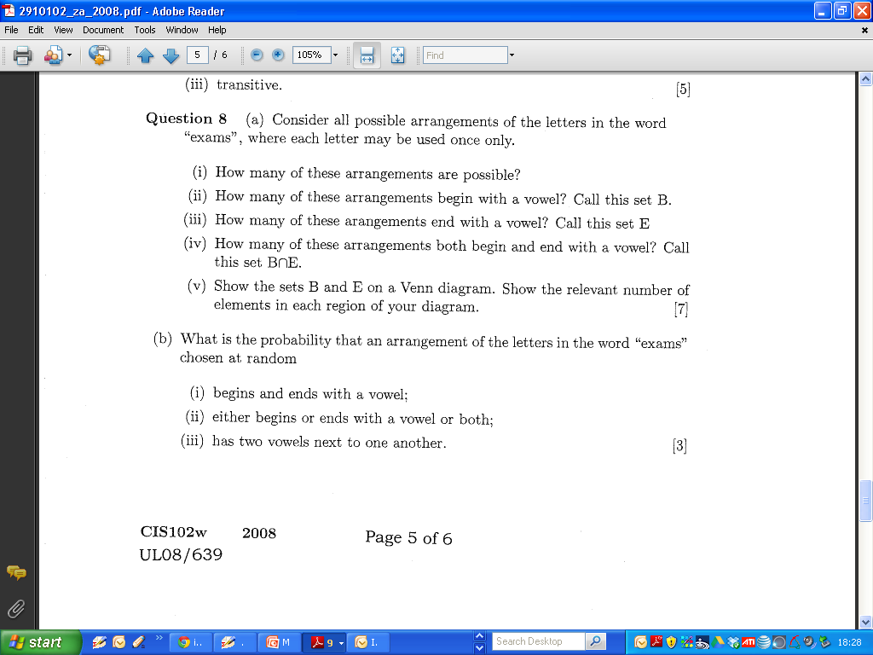
2008 Zone A

Slide 35
2008 Zone A

Slide 36
2008 Zone A

